Slide 1
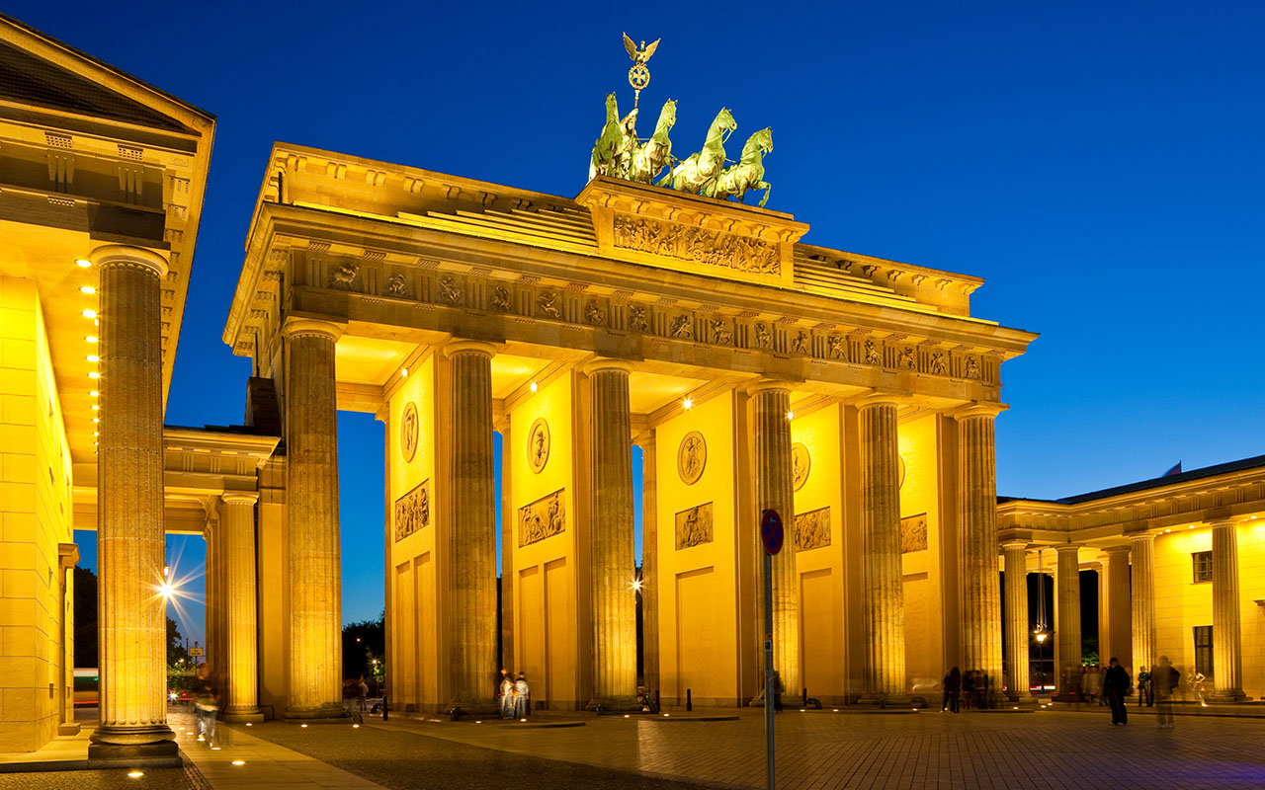
Berlin
DISCOUNTED REGISTRATION ENDS 8/4/18
v
REGISTER TODAY!
International Skeletal Society
45TH ANNUAL MEETING AND MUSCULOSKELETAL IMAGING COURSE: FUNDAMENTALS TO ADVANCED CONCEPTS
September 26 - 28, 2018 Berlin, Germany
facebook.com/intskeletalsociety
@intskeletal
www.internationalskeletalsociety.com

